Slide 1
TTIP/CETA/TISA
A Corporate Power Grab

Slide 2
Is TTIP a Trade Deal?
The main goal of TTIP is to remove regulatory ‘barriers’ which restrict the potential profits to be made by transnational corporations on both sides of the Atlantic. These ‘barriers’ are in reality some of our most prized social standards
TTIP also seeks to create new markets by opening up public services and government procurement contracts to competition from transnational corporations, threatening to introduce a further wave of privatisations in key sectors, such as health and education.

Slide 3
Is TTIP a Trade Deal?
TTIP is therefore correctly understood not as a negotiation between two competing trading partners, but as an attempt by transnational corporations to open up and deregulate markets on both sides of the Atlantic.

Slide 4
Regulatory convergence; as threatening as ISDS!
A lot of the criticism of the EU/US TTIP deal has centred on the ISDS provisions.
But recently leaked EU TTIP proposals reveal an equally insidious system of regulatory cooperation between the sides that will enable decisions to be made without public oversight or engagement.
Business will be involved from the beginning of the secretive process, well before any public debate takes place, and will have excellent opportunities to ditch important initiatives.

Slide 5
Regulatory convergence - three distinct processes
Mutual recognition
Harmonisation
Regulatory cooperation

Slide 6
Regulatory convergence
Mutual recognition
Would be implemented between the two trading blocs for a given set of – for example – safety standards; a US product that meets the US standards would automatically be allowed into the EU - even if it does not meet EU standards - and vice versa.

Slide 7
Regulatory convergence
Harmonisation
After US standards on pesticides, for example, are accepted by the EU for products that it imports, the next step for the industry is to get those standards in the EU down to the same lower level. For instance, the pesticide lobby document demands "significant harmonisation" between the US and EU rules for establishing limits for how much of a pesticide can remain in food and feed products.

Slide 8
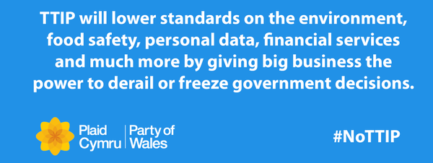
Regulatory convergence
Regulatory cooperation
Under TTIP’s chapter on 'regulatory cooperation', any future measure that could lead us towards – for example - a more sustainable food system or beneficial health – related regulations, could be deemed 'barriers to trade' and implementation could be refused before they see the light of day.

Slide 9
The Regulatory Cooperation Council (RCC)
The RCC would include ‘a streamlined procedure to amend the sectoral annexes of TTIP or add new ones, through a simplified mechanism not entailing domestic ratification procedures’. This leaves little scope for democratic control over regulatory decisions.
A ‘multi-stakeholder advisory committee’ is ‘to regularly meet and work with ... the regulators in crafting regulatory measures or in taking decisions on how to further compatibility of existing ones.

Slide 10
Regulatory Cooperation is as BIG a threat as ISDS!!!
Regulatory co-operation can provide a space and ratcheting mechanism for business groups and regulators to reach results to their liking long after TTIP is agreed, in the long term and with little public scrutiny.
Business Europe and the US Chamber of Commerce presented the EC with a series of proposals in 2012, which would enable them – in their words – ‘to put stakeholders at the table with regulators to essentially co-write regulation.’

Slide 11
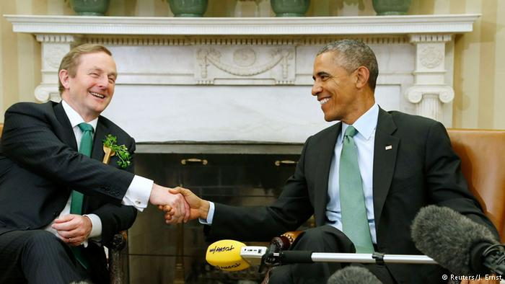
TTIPING HIS CAP!
According to Deutsche Welle, Obama and Kenny used the occasion to pledge support for the US-EU free trade agreement TTIP, with Kenny stating that the next six months would be imperative in deciding if the deal can come to fruition before the president leaves office.
"We're very big supporters of this," Kenny told reporters.

Slide 12
The Precautionary Principle.
The US government has explicitly stated that it will use the TTIP negotiations to target EU regulations that block US food exports.
These regulations rely on the ‘precautionary principle’ to set standards on food safety; a product may be withdrawn from the market if there is a risk that it may pose a danger to human health, even if there is insufficient scientific data on which to base a full evaluation of that risk.
Notes:
Ireland’s agriculture relies heavily on export- 90% of net beef output is exported according to Teagasc while 85% of dairy is exported. Irish farmers will be going into direct competition with US farmers following TTIP ratification

Slide 13
It makes sense!
Critically, the principle transfers the burden of proof to any company seeking to market a potentially dangerous product: the company is required to prove that it is safe.

Slide 14
The Precautionary Principle.
The US government does not employ the precautionary principle, and corporate interests have prevailed in setting US food safety standards at levels far lower than in the EU member states. The ‘regulatory convergence’ agenda of TTIP would bring EU standards closer to those of the USA.
Famous Examples: US producers of chicken and turkey regularly treat bird carcasses with chlorine before selling them on to consumers – a process that has been banned in the EU since 1997 and over 90% of US beef is produced with the use of bovine growth hormones that have been linked to cancers in humans, and EU restrictions on the import of such beef have been in place since 1988.
Notes:
Around 70% of all processed foods sold in US supermarkets contain genetically modified ingredients. By contrast, very little GM food is on sale in European supermarkets, and any food that does contain GM ingredients must be clearly labelled as such.

Slide 15
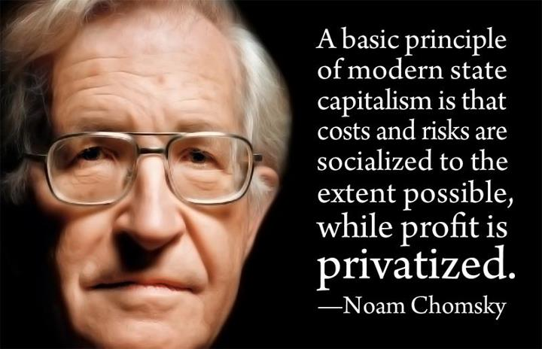
The Privatisation Agenda!
TTIP aims to secure the liberalisation of services markets, including the opening of public services such as health, education and water to private firms.
If TTIP is adopted, it will become effectively impossible for countries to restore public services if they have already been privatised. It will become absolutely impossible, if TTIP adopts the ‘negative list’ approach whereby all service sectors are surrendered to liberalisation unless they are specifically marked out as exceptions (the ‘list it or lose it’ model).

Slide 16
The Privatisation Agenda
This would be a dramatic shift away from the ‘positive list’ approach traditionally employed by the EU member states, where only those sectors actively put forward for inclusion are opened up to competition from foreign firms.
EU business groups have joined with their US counterparts in calling for the negative list approach to be used in TTIP in order to maximize the number of service sectors included for liberalisation.

Slide 17
Reservations Applicable to Ireland CETA ( EU Annex 2: 4th August 2012)
That’s it!

Slide 18
.
SMASH AND GRAB!
If Canadian/US companies or Canadian/US domiciled subsidiaries successfully bid for contracts in any area without a reservation and a future government decides that it wants to revert to a public system, those companies will be able to sue for huge compensation.
There are no provisions on investor’s obligations - only rights!

Slide 19
Labour Standards
TTIP would lead to a downgrading of any labour standards identified as ‘barriers’ to trade, such as collective labour agreements.
The US government has refused to ratify ILO Conventions on core labour standards such as collective bargaining, freedom of association and the right to organise.
Around half of all US states have now adopted anti-trade union legislation under the so-called ‘right to work’ that undermines trade union finances and allows businesses to undercut workers’ pay, health insurance and pensions.
Business sees TTIP as an opportunity to relocate production to where wages and workers’ rights are lowest, creating its own ‘race to the bottom.
Notes:
– just one example cited in a report for the European Commission on measures that represent an “impediment” to EU-US trade.
The United States has not yet ratified Conventions Nos 29, 87, 98, 100, 111 and 138.
98 Workers shall enjoy adequate protection against acts of anti-union discrimination in respect of their employment.
87 Freedom of association

Slide 20
What about Jobs?
In November 2014 Minister Bruton said TTIP: “ …would add 0.5% to EU GDP and create 400,000 extra jobs.”
This figure is based on the IFO study which the European Commission itself said are unrealistically high
European Commission, ‘TTIP: The Economic Analysis Explained’, September 2013.
This figure is an estimate of what might happen were the US to be fully integrated into the EU’s internal market.

Slide 21
What about Jobs?
The Centre for Economic Policy Research’s (CEPR) study for the EU Commission, recognised that at least 1.3 million EU workers would lose their jobs arising from labour displacement under the Commission’s preferred outcome.
Notes:
The studies use complex economic models or statistics and arrive at apparently precise and definite results, even if a more detailed examination of the reports may sometimes indicate strong qualifications.
The application of such models can appear to give very strong scientific support for policy choices. However, the reliability of claims derived from them depends on the strength of the data, the appropriateness of the theory used and the assumptions or guesses and estimates made along the way.
There are grounds for doubting the significance of many of the overall benefits most prominently mentioned in public discussion of the TTIP.

Slide 22
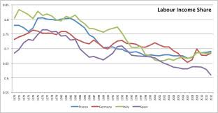
And wages?
CEPR estimates they will increase at the same rate as GDP – totally out of line with the 30 years before the crisis, when labour’s share of GDP in the EU-15 countries declined sharply from 67% in mid-70s to 57% in 2007.

Slide 23
The CEPR MODEL (CGE)
CEPR conclusions have cast doubt on the basic underlying rationale for the trade deal, which is that TTIP will help the United States and the EU TO emerge from the recession.
Their model starts with the assumption of fixed full employment - jobs are never created or lost, but simply move from sectors that become less competitive under the deal, to more competitive ones.

Slide 24
The CEPR MODEL (CGE)
Studies using the CGE model are inherently not focused on the labour market and fail to account for the costs to an economy incurred when workers lose their jobs.
The CEPR Model also ignores regional variation.

Slide 25
Measuring the impact of the elimination of non-tariff barriers (NTBs).
The CEPR study estimated gains for the EU of 0.5 percent in GDP growth over 10 years. This translated into an extra €545 in disposable income each year for a family of four in the EU - on average €2.60 each per week.
So, even if CEPR’s most optimistic scenario is true, just look at all we might have to give up for an extra cup of coffee per week!
Notes:
Depending on the assumptions around the variables, the results of the analysis can vary widely.

Slide 26
Down with regulation!
Presidents Barroso, Van Rompuy and Obama have made it clear that reducing regulatory barriers to trade will be one of the most important ways that TTIP will help the EU and US economies.

Slide 27
An Introduction to TISA
At the beginning of 2012, about 20 WTO members (the EU counted as one) launched secret unofficial talks towards drafting a treaty that would further liberalize trade and investment in services, and expand "regulatory disciplines" on all services sectors, including many public services.

Slide 28
An Introduction to TISA
The treaty rules, would provide all foreign providers access to domestic markets at "no less favourable" conditions than domestic suppliers and would restrict governments' ability to regulate, purchase and provide services.
This would change the regulation of many public and privatised or commercial services from serving the public interest to serving the profit interests of private, foreign corporations. Doesn’t that sound familiar?

Slide 29
An Introduction to TISA
Corporate interests are seeking to weaken national controls that protect data privacy and even after the 2008 global crisis, TISA seeks to further liberalise financial markets.
TISA also promotes the temporary movement of professionals and workers and in committed sectors would eliminate the legal onus on employers to hire local workers if they are available.

Slide 30
TISA – TTIP on Steroids
TISA negotiations are covering: financial services;
Telecommunications and e-commerce);
professional services;
maritime transport services; air transport services,
competitive delivery services; energy services;
temporary entry of business persons; government procurement;
and new rules on domestic regulation to ensure regulatory settings don’t operate as a barrier to trade in services.
And if the last point sounds familiar, it's
because very similar language is used in
the provisions of CETA/TTIP

Slide 31
TTIP, TISA and CETA should be scrapped
Ordinary people stand to lose out significantly as yet more powers are handed over to transnational corporations – continuing the redistribution of wealth from labour to capital that has been a defining characteristic of both the EU and US economies over the last decades.
These are deals solely designed to make corporate power the absolute dominant force in society.
TTIP, TISA and CETA should be scrapped.

Slide 32
“I sometimes find it difficult to convey how utterly boring trade negotiations are. And …. those who now follow the trade negotiations are discovering just how boring they are. And they are therefore convinced that we are hiding something from them, because there must be something more exciting going on.” ( ((David O'Sullivan, EU Ambassador to the US on TTIP)

Slide 33
Scrap TTIP, TISA and CETA
TTIP is likely to bring “prolonged and substantial” dislocation of EU workers.
(EU Commission)
.
Notes:
The position of the Irish government. Ireland lost its veto on these matters with the ratification of the Lisbon Treaty. Therefore we need a strong Irish position to protect Ireland’s interest. Unfortunately the government seem content to sleepwalk us into another bad deal. That Minister Richard Bruton joined 13 of his EU counterparts in signing a letter to Commission President, Jean-Claude Juncker, supporting the inclusion of an Investor State Dispute Settlement (ISDS) mechanism is worrying. That he did so without any recourse to the Irish people is downright scandalous.

Slide 34
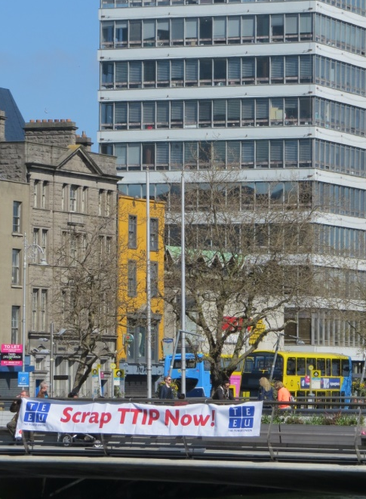
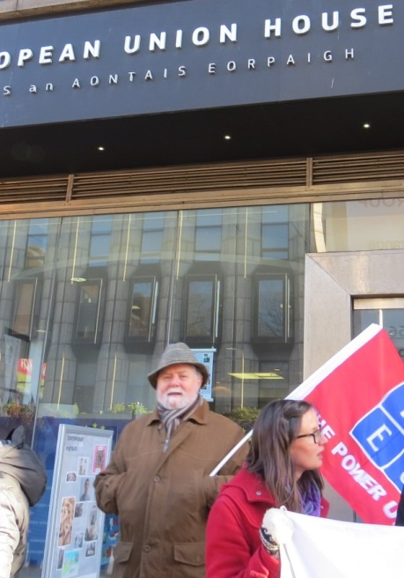
TEEU Biennial Delegate Conference 2014 Motion
25. Transatlantic Trade and Investment Partnership (TTIP):
…. resolves that the TEEU oppose the ratification and implementation of this agreement at all forums in which it participates; inform the relevant government agencies of our opposition to TTIP; encourage other trade unions to join us in opposition and calls for its scrapping.

Slide 35
The People’s Movement
.
www.people.ie post@people.ie
peoplesmovementireland

Slide 36
.
Peoples Movement: https://www.facebook.com/peoplesmovementireland
AntiAusterity Alliance https://www.facebook.com/AntiAusterityAlliance
Uplift: https://www.facebook.com/UpliftIreland
TTIP information Network : https://www.facebook.com/TTIPInformationNetwork
Ireland against TTIP: https://www.facebook.com/groups/1481844492091679/?fref=ts
Artists against TTIP: https://www.facebook.com/AATTIP

Slide 37
FDI - Foreign Direct Investment
According to CEPR, removing NTBs to foreign direct investment gives a 9.4% increase in employment by US affiliates in Europe, and an increase in profits of EU firms in the US of €10.3 billion.
But substitution effects, - how the increased economic activity that is calculated displaces other activities – are omitted.
These are crucial because FDI is an alternative to exports for serving foreign markets and would normally reduce exports to the host region/country.
Notes:
Reduction of NTBs would make it easier for US firms to serve the EU market by exports from the US – an express purpose of TTIP. This would tend to reduce employment in US MNCs in Europe. CEPR seems to overstate the total positive effects of FDI.

Slide 38
It could be rough!
The CEPR analysis only addresses inter-industry job change, where people switch industries.
However, the study shows this kind of trade amounting to only 20% of their projected increase in trade - the other 80% would be in the form of intra-industry trade (where both exports and imports in the same sector increase) and would imply further displacement.
A higher level of job displacement than considered in the study and significant transition periods between jobs seem likely due to these issues, and the difficulties would be compounded in a context of likely high unemployment, if the current austerity policies continue - under the terms of the EU Fiscal Treaty.

Slide 39
Measuring the impact of the elimination of non-tariff barriers (NTBs).
Jeronim Capaldo, of Tufts Global Development Institute, argued that TTIP would result in a loss of GDP for all EU countries and that 600,000 jobs would be lost in the EU.
His model did not assume fixed employment but used an employment estimation based on the relationship between productivity growth and employment numbers, using data from the ILO.
Rudi von Arnim, found that the gains claimed are small enough to be in the rounding margin of error, and could easily be offset by the adjustment costs associated with implementing TTIP. Unemployment benefits and trade adjustment could eat away one-third of the claimed GDP benefits.

Slide 40
Measuring the impact of the elimination of non-tariff barriers (NTBs).
The assumption of full employment in a CGE model always yields projections of net gains.
The assumption that expanding sectors can absorb the workers displaced by contracting sectors is unrealistic because the rate of expansion does not match the rate of jobs being lost.
Labourers are not necessarily transferable between sectors because of sector-specific skill requirements.
The cost of adjustment to remove NTBs, including higher levels of unemployment and lost tariff revenue, is neglected in recent CGE models, so the gains of cutting NTBs is overstated.

Slide 41
Measuring the impact of the elimination of non-tariff barriers (NTBs).
The assumption of full employment in a CGE model always yields projections of net gains.
The assumption that expanding sectors can absorb the workers displaced by contracting sectors is unrealistic because the rate of expansion does not match the rate of jobs being lost.
Labourers are not necessarily transferable between sectors because of sector-specific skill requirements.
The cost of adjustment to remove NTBs, including higher levels of unemployment and lost tariff revenue, is neglected in recent CGE models, so the gains of cutting NTBs is overstated.

Slide 42
The EU’s figures are not very convincing!
The benefits estimated by the key impact study for the European Commission (CEPR) are very small indeed: one - twentieth of one per cent increase in growth rate in the most optimistic scenario, for a period of 10 years.
There would be an increase in disposable income of €2.60 per week per person in the EU in the most optimistic scenario, or €1.50 in a more realistic one, after 10 years. Essentially, on these estimates the TTIP would have no impact in getting us out of the crisis.
So, even if CEPR’s most optimistic scenario is true, just look at all we might have to give up for an extra cup of coffee per week!

Slide 43
And what’s happening to CETA?
CETA is a deal between the EU and Canada – similar to TTIP. It must still be approved by the European Council and the European Parliament, to come into effect in 2016.
Germany and France have indicated that they want to reopen CETA to change the ISDS provisions, while Denmark, Luxembourg, Netherlands, Sweden, Austria, Belgium, Italy and Greece are also concerned.

